Slide 1
Comparative Adjectives
When we want to compare two things we use comparative adjectives.
1. Use -er for one-syllable words
For one-syllable words we add -er to the adjective to make it a comparative. The following are all one syllable adjectives:
Small- smaller Cheap -cheaper
Quick – quicker
Canada is colder than Honduras
A mouse is faster than a turtle

Slide 2
Note - If the adjective ends in a consonant-vowel-consonant combination (CVC), double the final consonant before adding –er:
Big- bigger Hot- hotter Wet- wetter
2. Use -ier for adjectives ending with y
For most adjectives that end with a y we change the y to i and add er:
Dirty-dirtier Smelly- smellier Ugly- uglier

Slide 3
3. Use more / less for two+ syllable words
Adjectives with two or more syllables take more / less:
Beautiful-more beautiful Sensitive-more sensitive Dangerous-more dangerous
4. Irregular forms
Some adjectives don't follow any of the above rules. Here are some of the most common irregular forms:
Good- better bad- worse far- farther

Slide 4
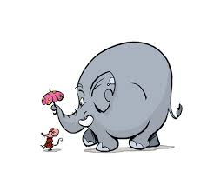
An elephant is bigger than a mouse
A mouse is smaller than an elephant
An elephant is heavier than a mouse
A mouse is more intelligent than an elephant

Slide 5
Exercise
Compare the following:
San Pedro Sula and Tegucigalpa
Mall Multiplaza and Plaza Miraflores
A cat and a dog
A baleada and a hamburger
Lionel Messi and Cristiano Ronaldo

