Slide 1
Can and can´t for ability
Grammar

Slide 2
Can and can´t
To talk about ability,
use can or can´t
and
the base form of a verb.

Slide 3

She can play the guitar.
subject + can + base verb + compliment

Slide 4
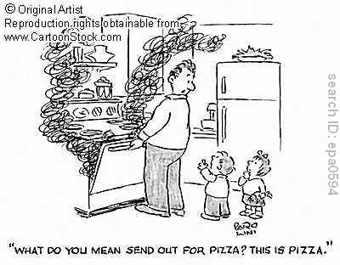
He can´t cook.

Slide 5
Using well with can and can´t
She can play the guitar well.
He can´t cook well.

Slide 6
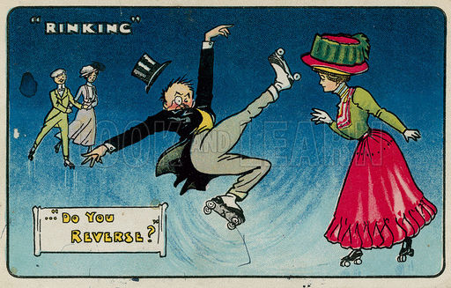
Use can or can´t with well to indicate
degree of ability.
He can skate, but he can´t skate well.

Slide 7
Questions with can
Can + subject + base verb?
Can you ____________?
Can he / she ____________?
Can they ____________?
Can we ____________?

Slide 8
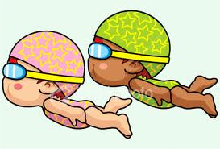

Short answers
Can you swim?
Affirmative:
Yes, we can.
Negative :
No, I can´t.

Slide 9
Don´t forget……
can´t = can not = cannot

