Slide 1
CARS

Slide 2
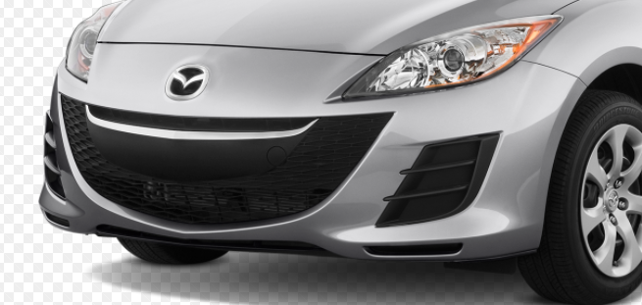
bumper

Slide 3

headlights

Slide 4
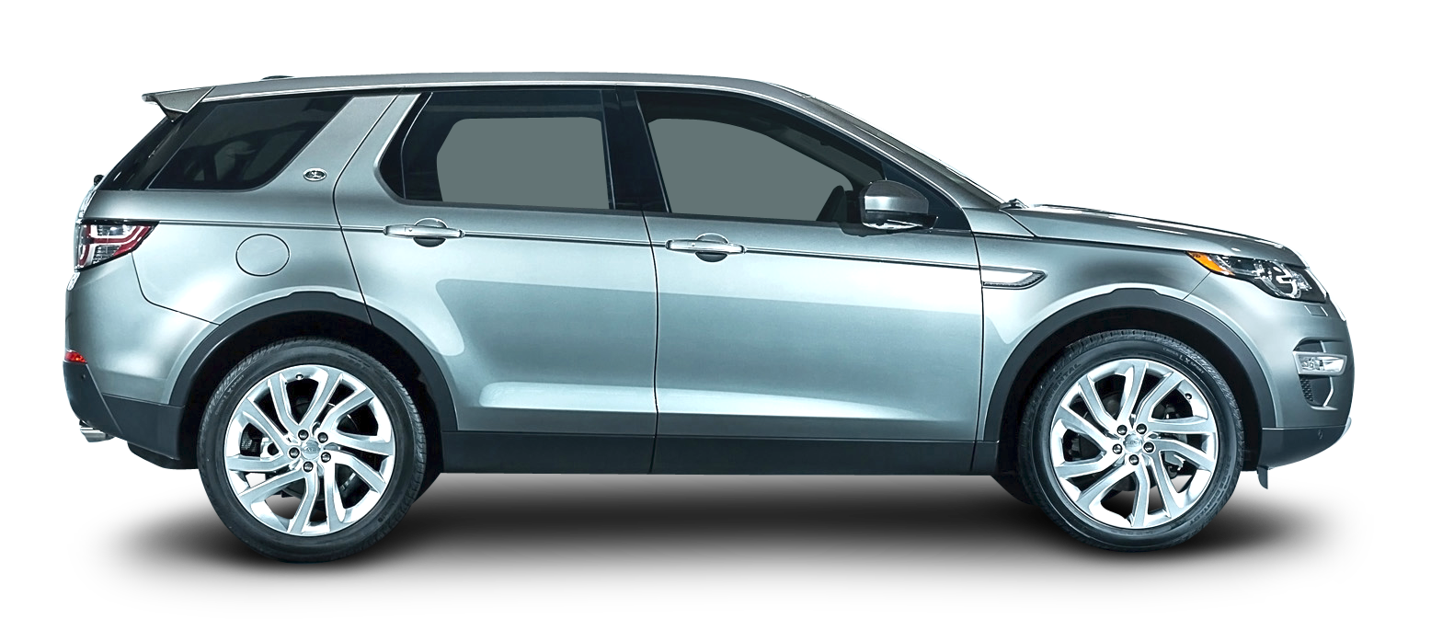
door
wheels

Slide 5
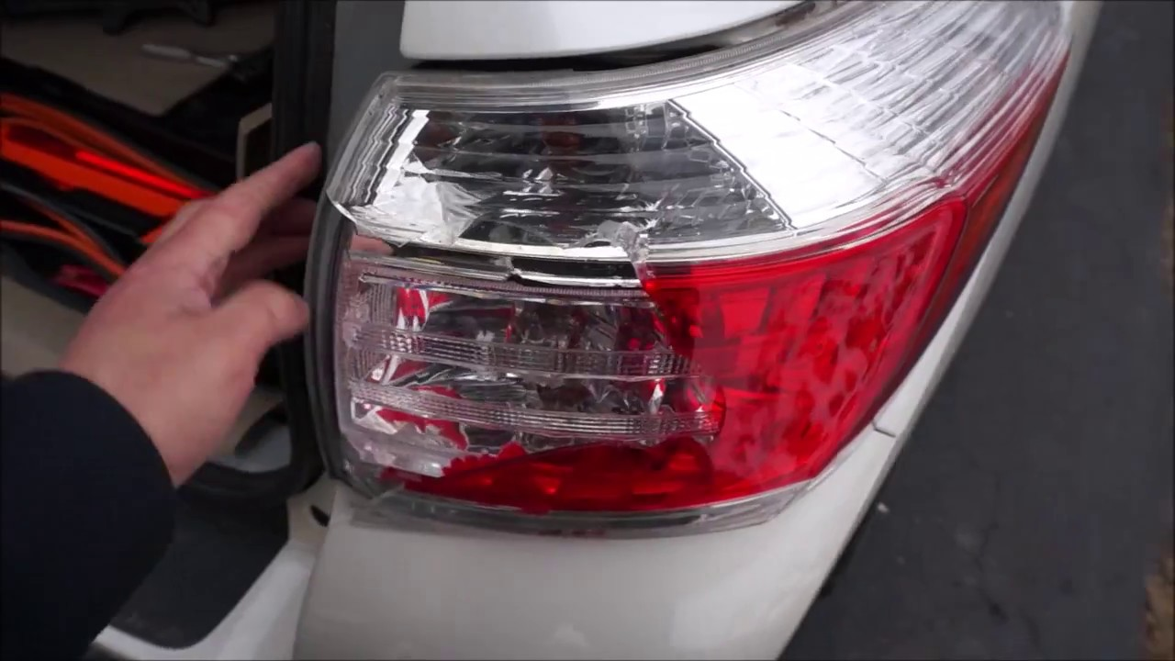
Tail lights

Slide 6
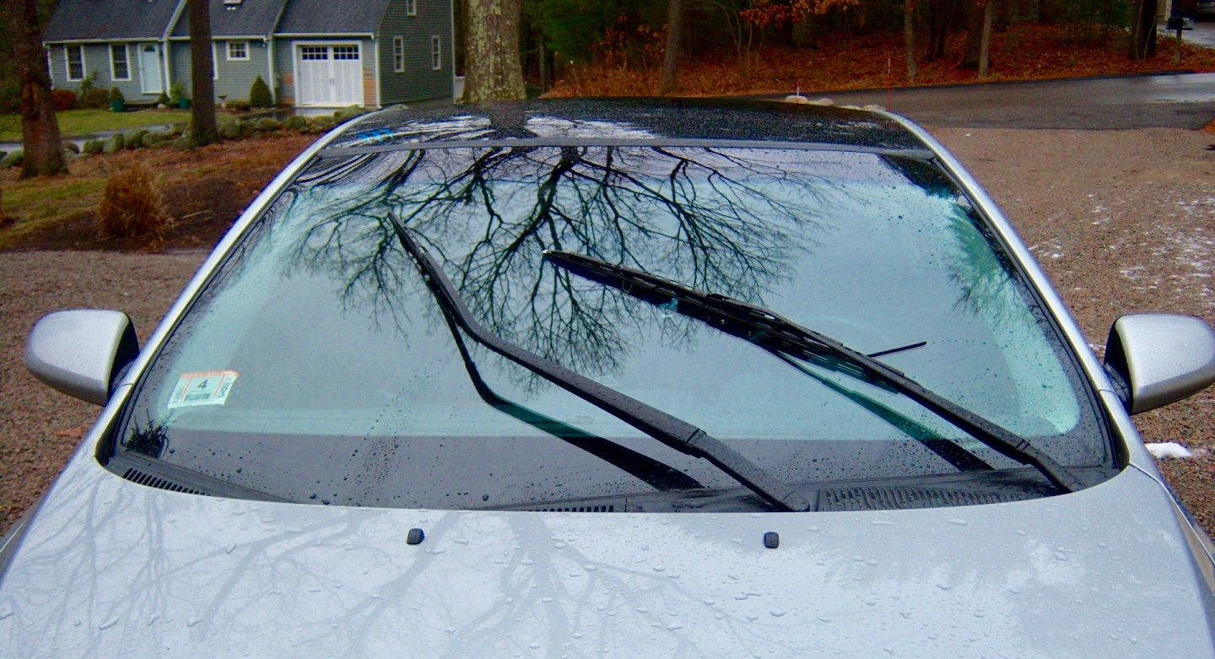
Windshield

Slide 7
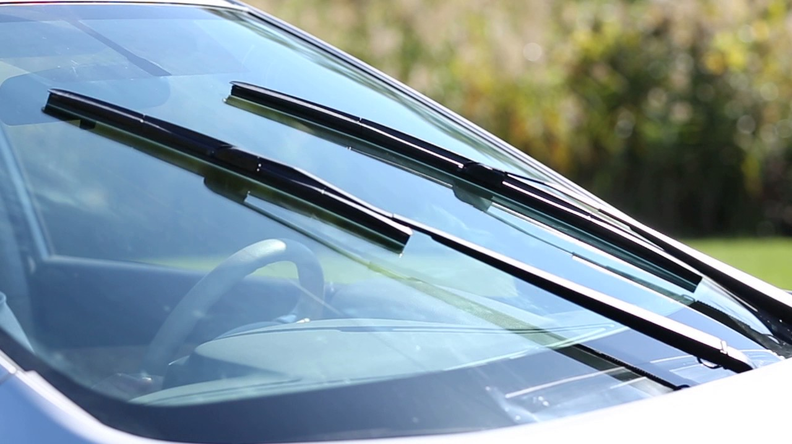
Windshield wipers

Slide 8
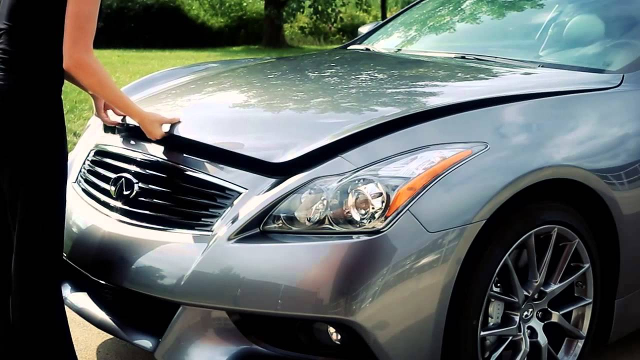
hood

Slide 9
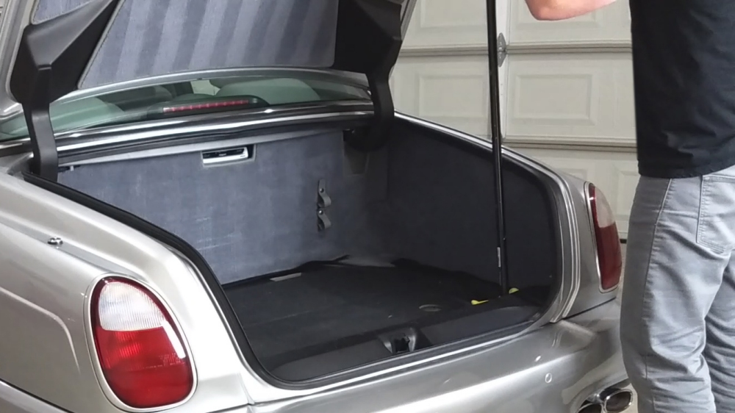
trunk

Slide 10
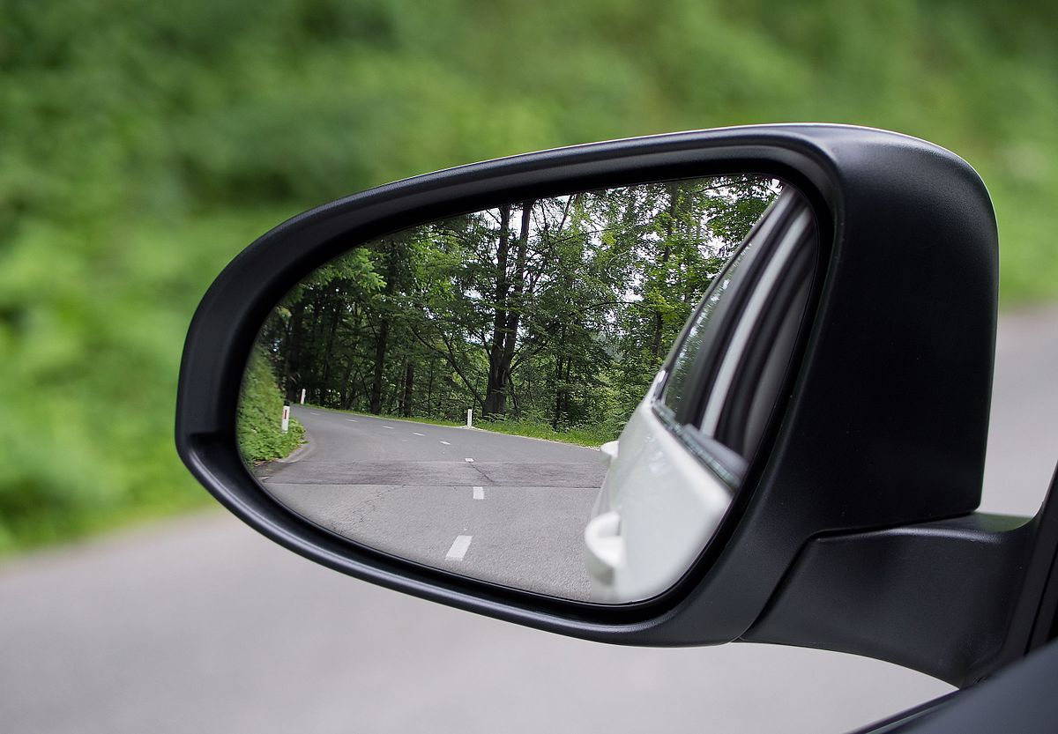
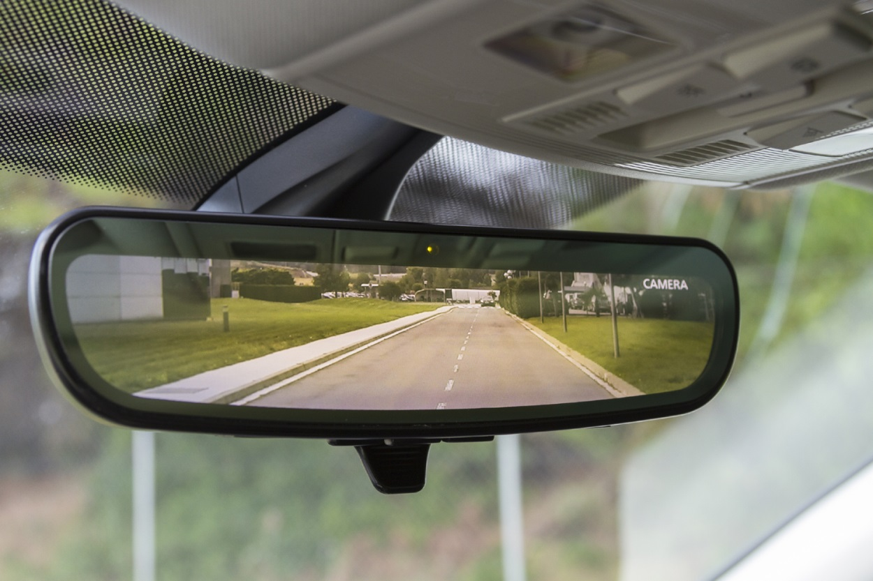
Side view mirror
Rear view mirror

Slide 11
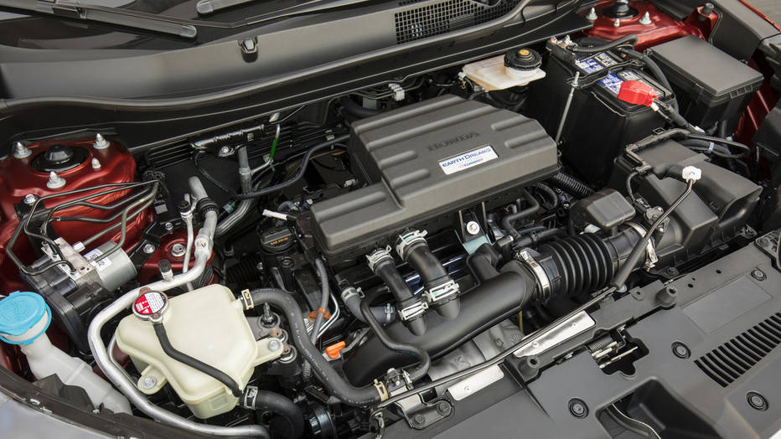
engine

Slide 12
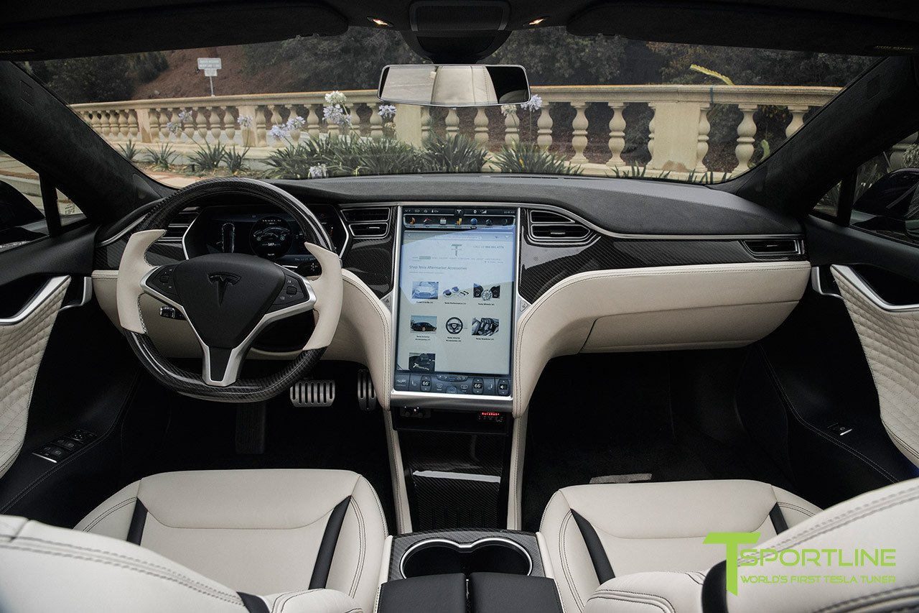
Steering wheel
dashboard
seats

Slide 13
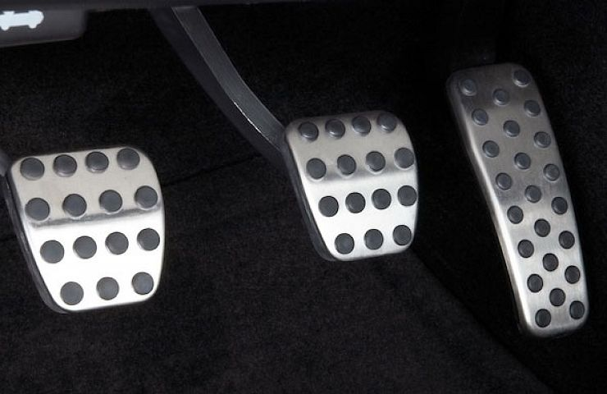
GAS PEDAL
BRAKE PEDAL
CLUTCH

