Slide 1
CAR PARTS

Slide 2
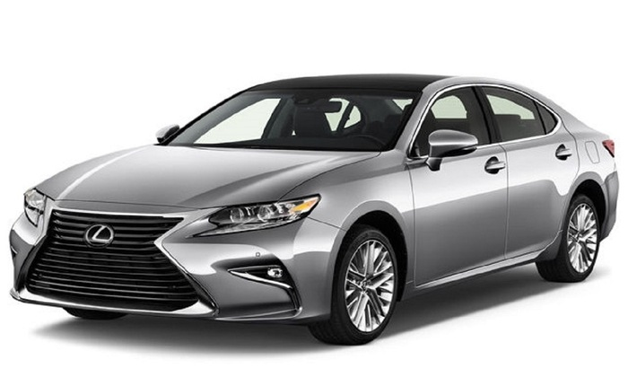
SEDAN

Slide 3
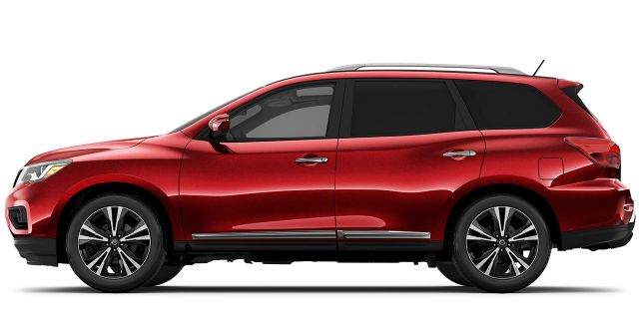
SUV
(SPORTS UTILITY VEHICLE)

Slide 4
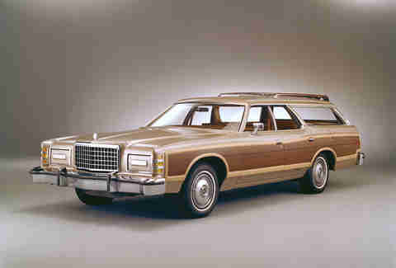
Station wagon

Slide 5

Compact

Slide 6
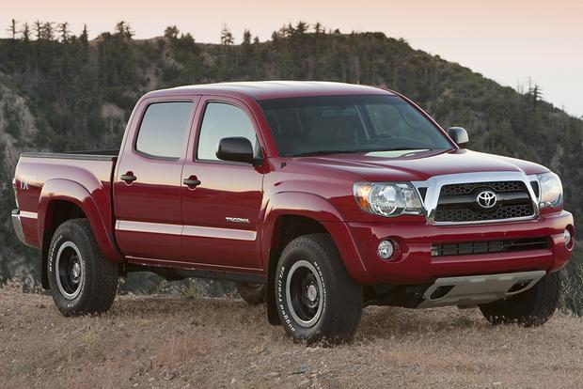
Pick up truck

Slide 7
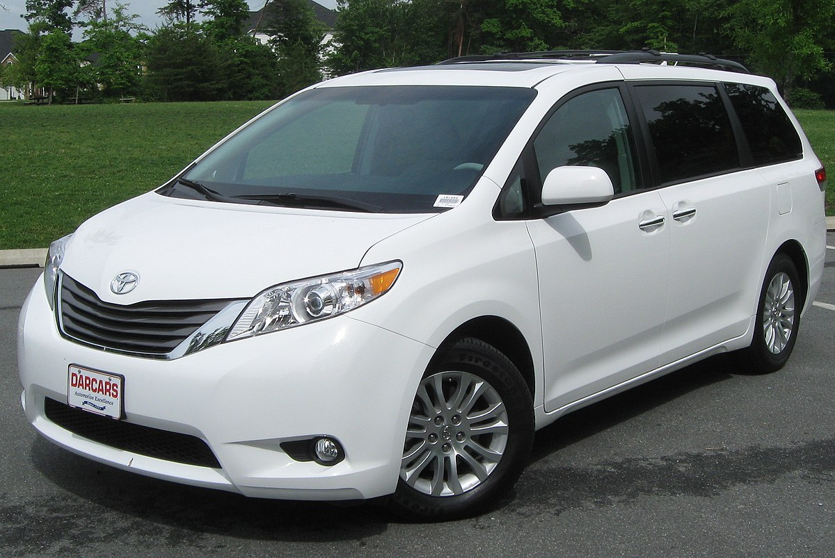
Mini van

Slide 8
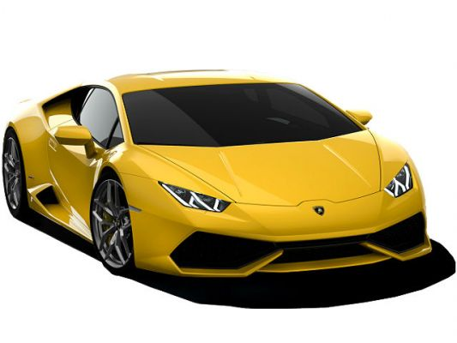
Sports car

Slide 9

convertible

Slide 10
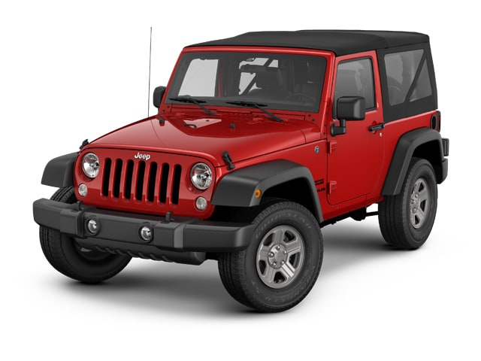
jeep

Slide 11
CAR PARTS

Slide 12
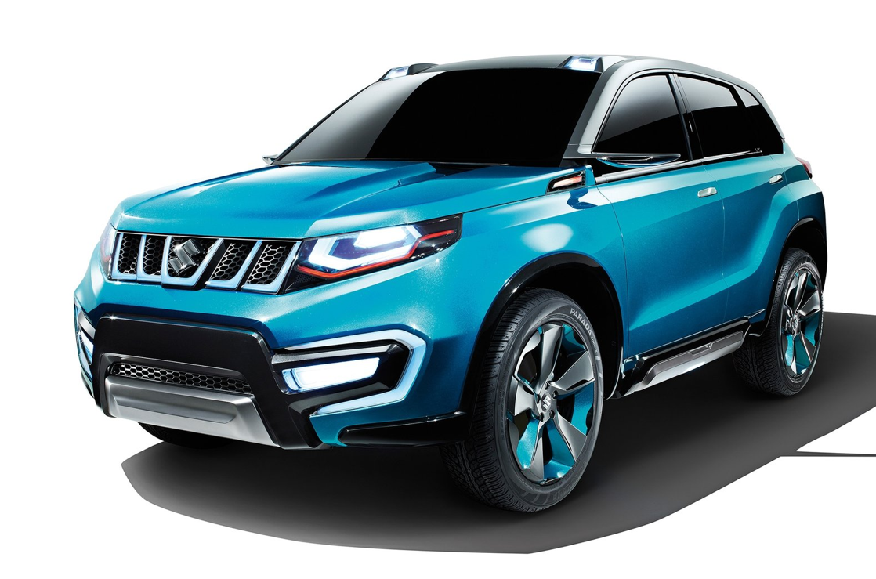
roof
doors
hood
bumper
wheels

Slide 13
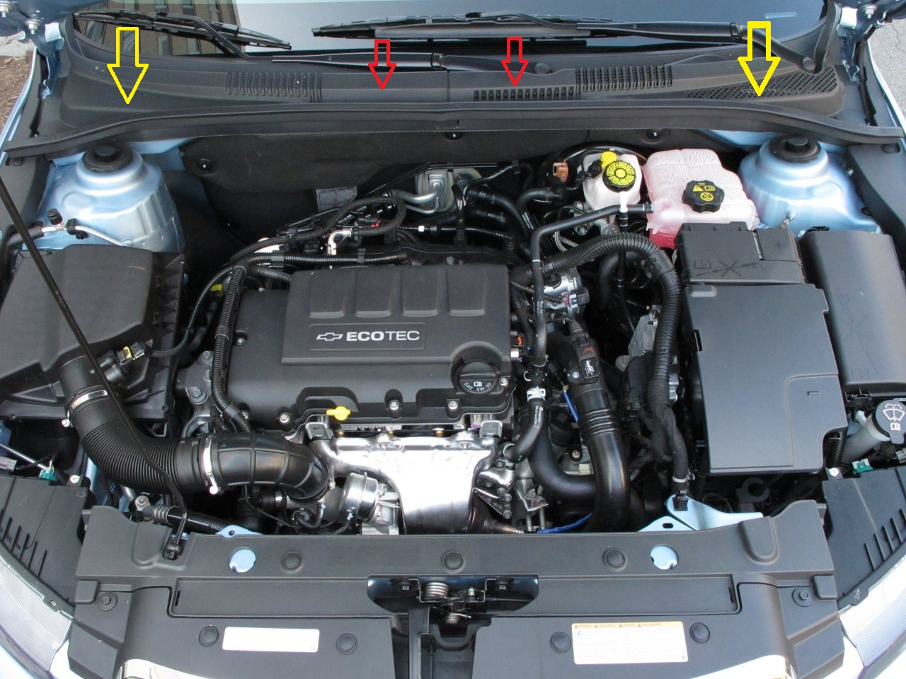
engine

Slide 14
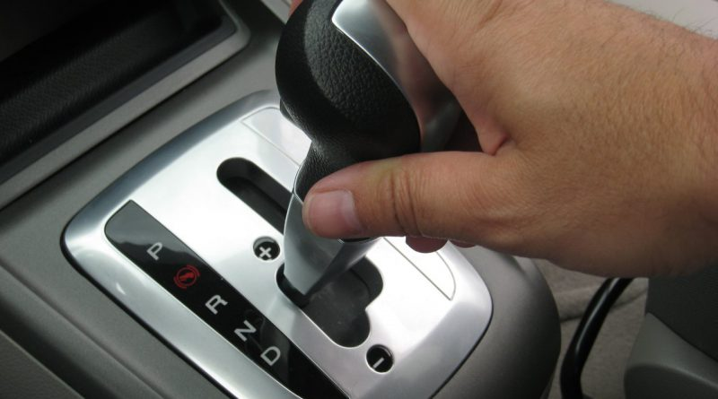
gear

Slide 15
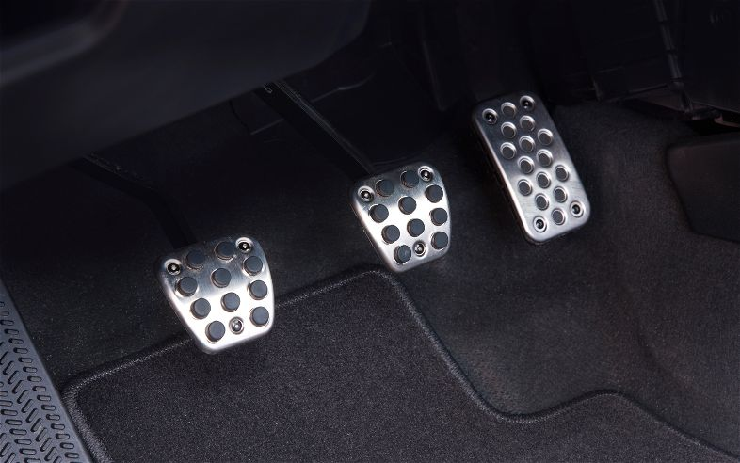
Gas pedal
Brake pedal
clutch

Slide 16
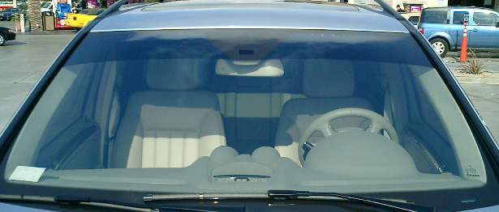
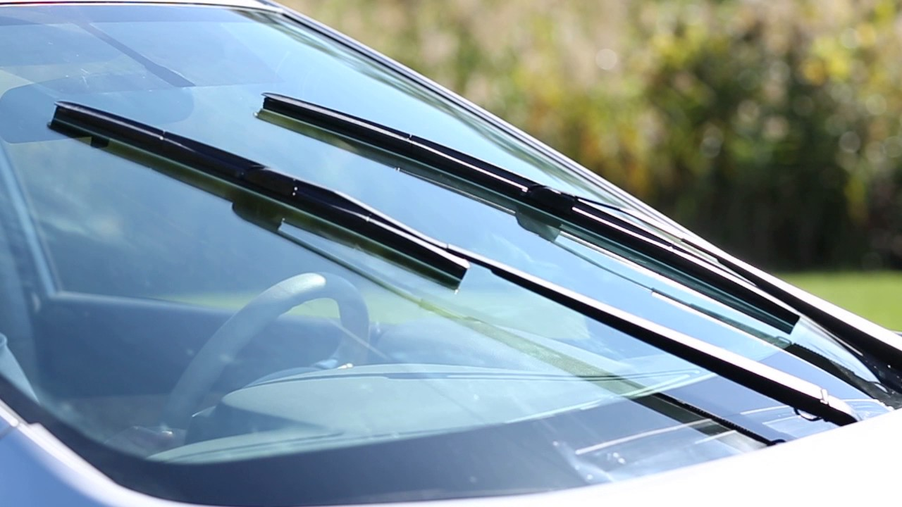
WINDSHIELD
WINDSHIELD WIPERS

Slide 17

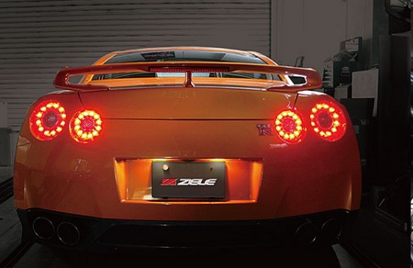
Head lights
Tail lights

Slide 18

Side view mirror

Slide 19
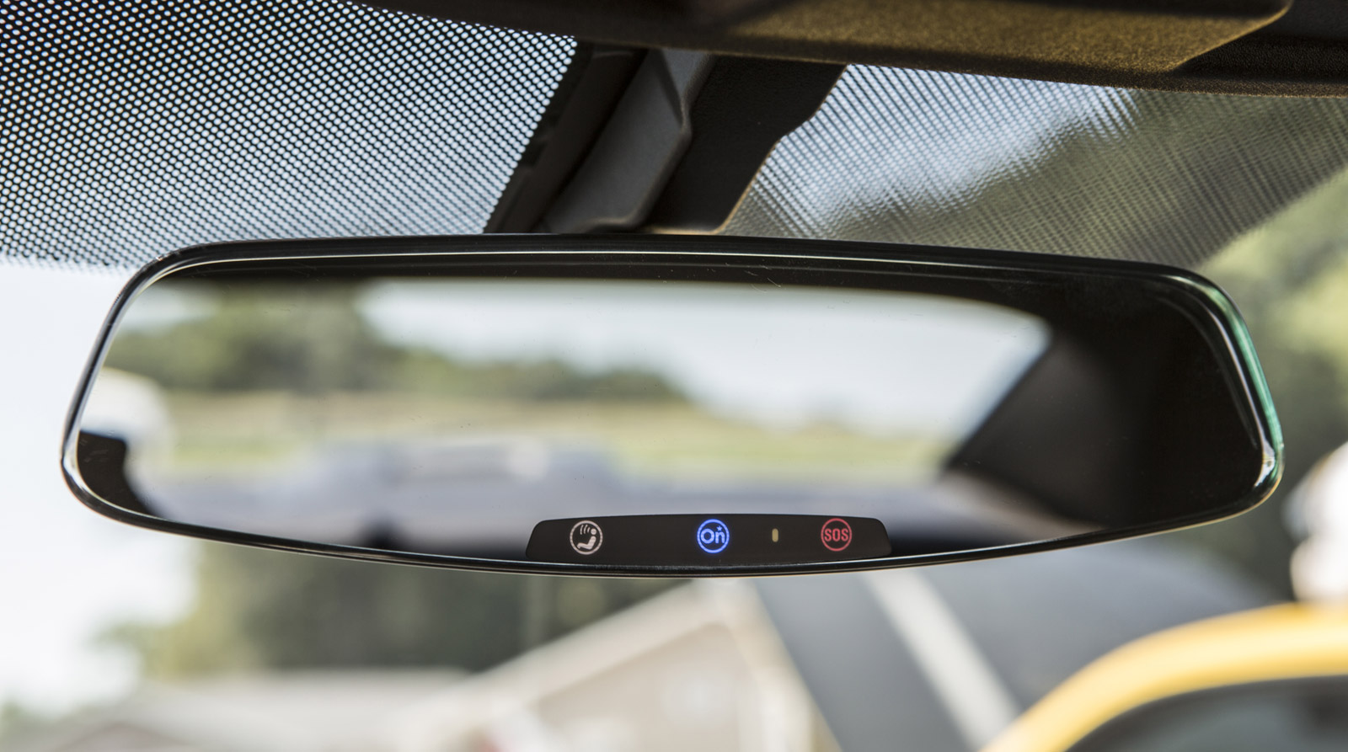
Rear view mirror

Slide 20
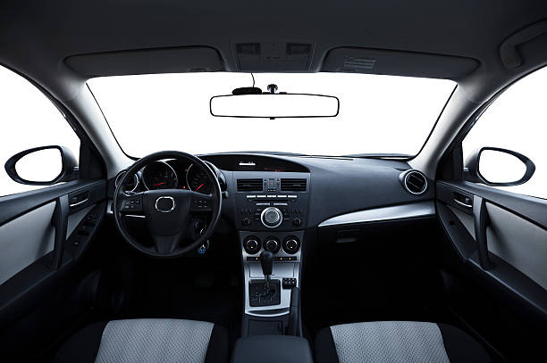
Dash board

Slide 21
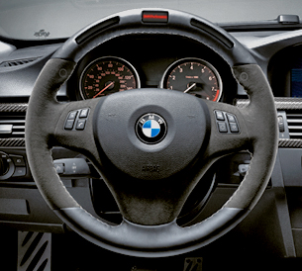
Steering wheel

