Slide 1
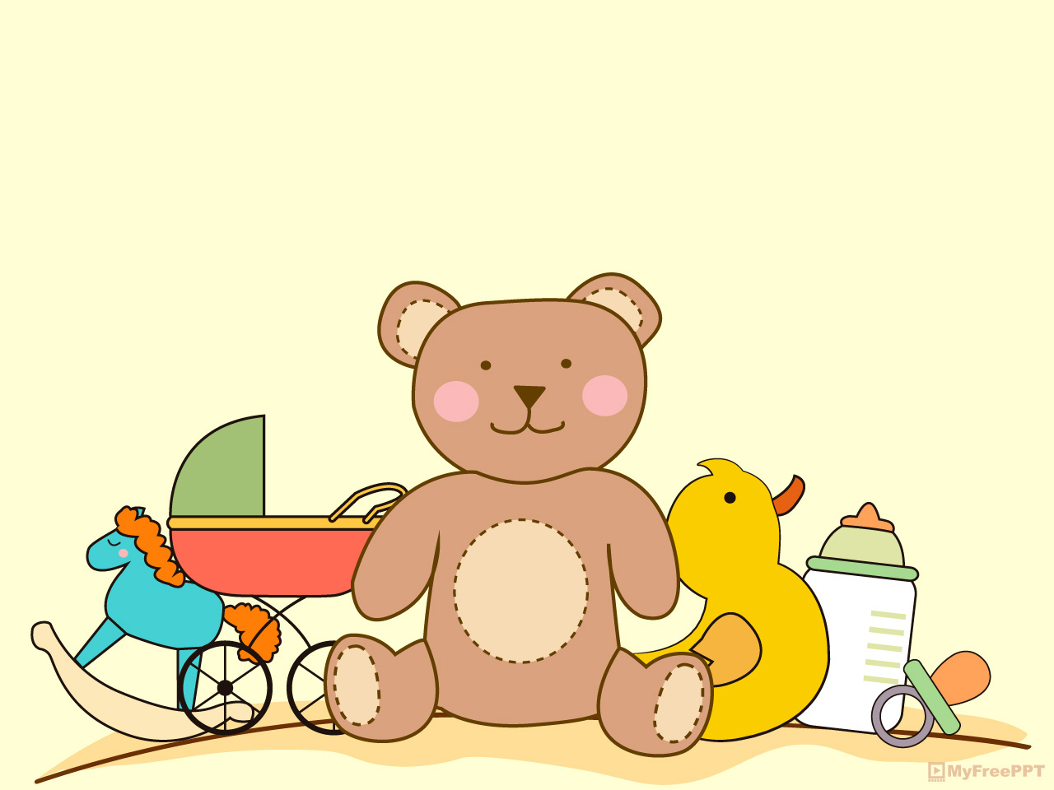
ABILITIES

Slide 2

swim

Slide 3

Play the guitar

Slide 4

Play the piano

Slide 5
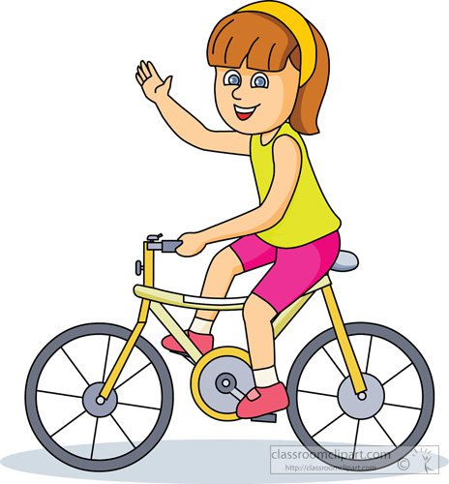
Ride a bicycle

Slide 6

Speak English

Slide 7
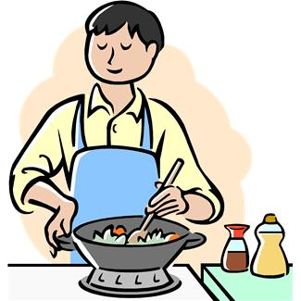
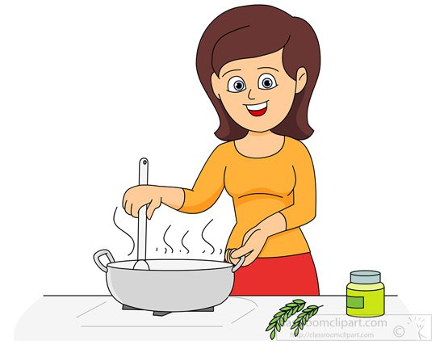
cook

Slide 8
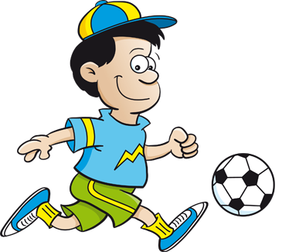
Play football

Slide 9
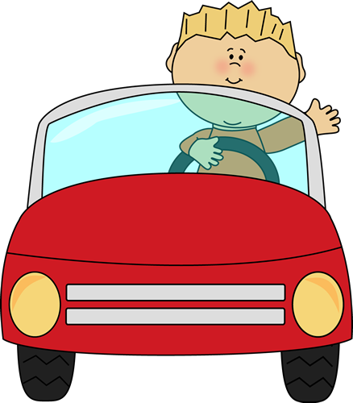
drive

Slide 10
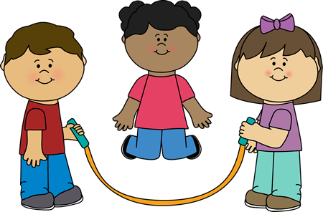
Jump rope

Slide 11
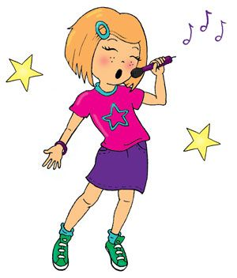
sing

Slide 12

fly

Slide 13
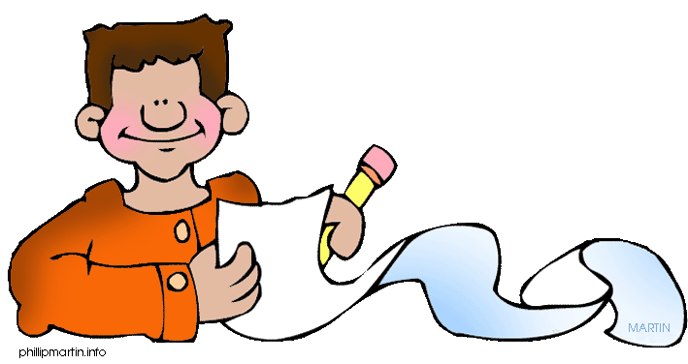
write

Slide 14

walk

Slide 15
Can can’t

Slide 16
Positive sentences

Slide 17
I YOU HE SHE CAN SING. IT WE aux + verb THEY

Slide 18
Negative sentences

Slide 19
I YOU HE SHE CAN’T SING. IT WE aux + verb THEY

Slide 20
Complete the exercise with POSITIVE SENTENCES.

Slide 21
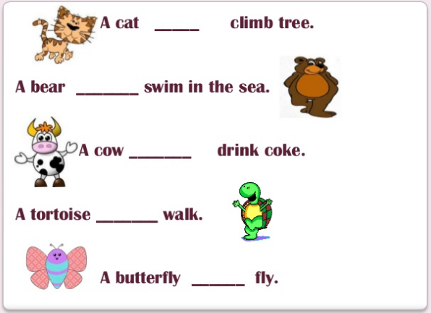

Slide 22
COMPLETE THE SENTENCES THAT ARE NEGATIVES.

Slide 23
