Slide 1
All about me
Diego Andres Cruz Obando

Slide 2
My personal information
Name:Diego Andres
age:14
where do i live:valle de angeles
what school i go to:Instituto Catolico San Fransisco de Asis

Slide 3
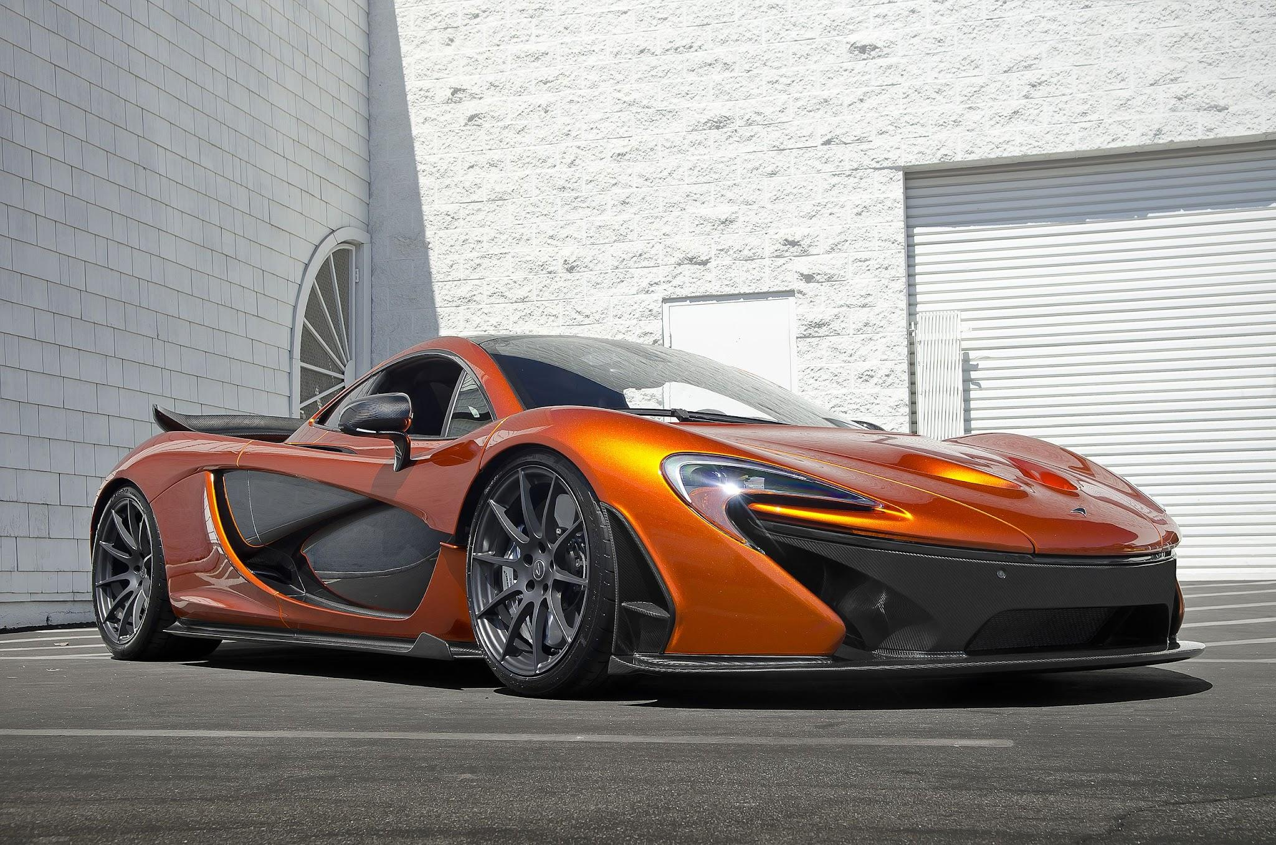
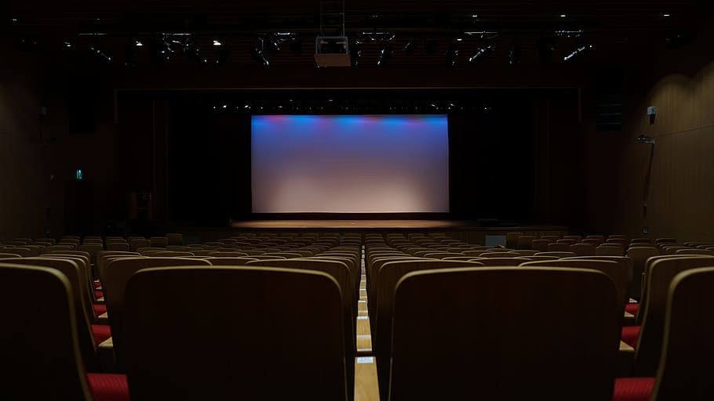

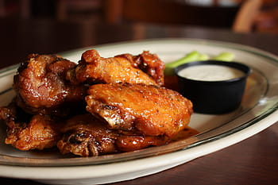
My favorite things
fav movie:shrerk
fav food:chicken wings
fav place:movie theater
fav car:mc claren p1

Slide 4
I don’t like to….
study
go to school
wait
annoying or loud sounds
the dark

