Slide 1
All About me
Amelia Salgado

Slide 2
Personal Information
My name: Amelia Salgado
My age: 15
I live in : Tegucigalpa,Col. La Campaña
School that I go : ISJC

Slide 3



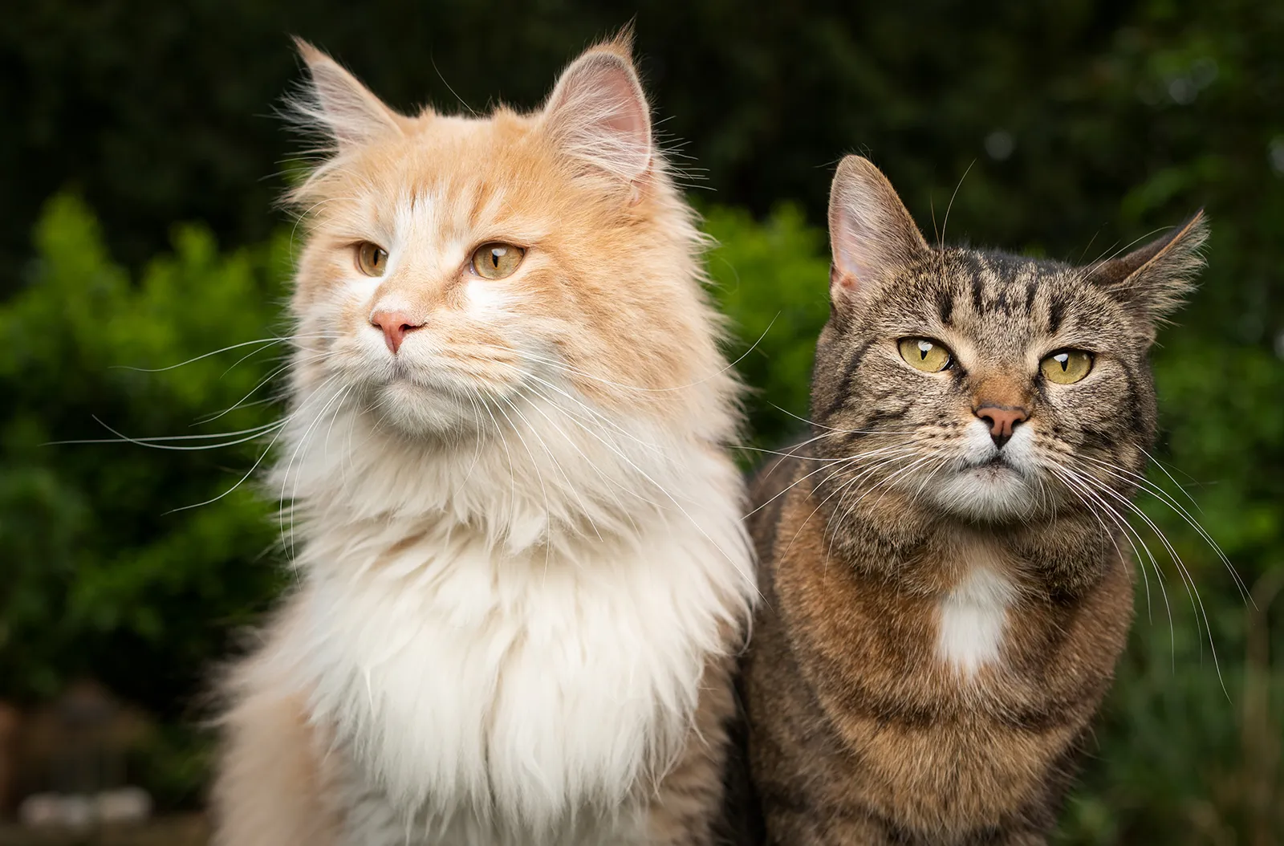
I liket to…
Sushi
Cat
Chai
Coffee

Slide 4
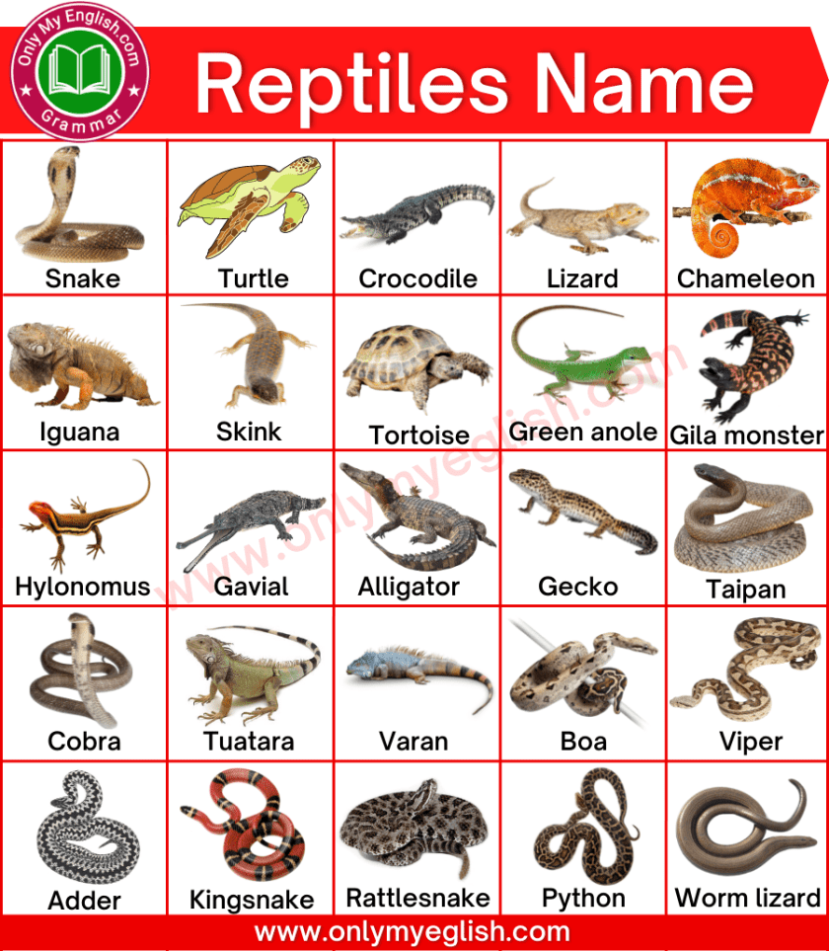
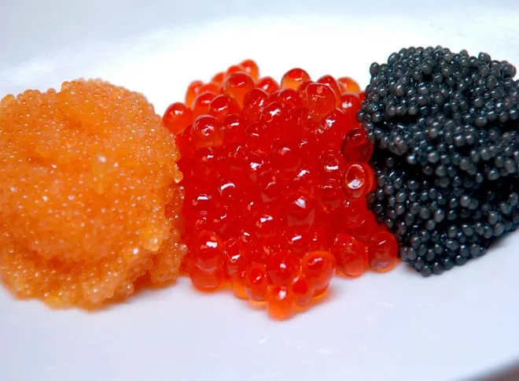

I don t like
Reptiles
Caviar
Exam

