Slide 1
Adjective Order
Upper intermediate
3.4

Slide 2
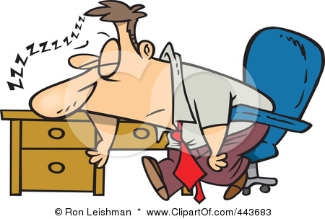
What are adjectives?
An adjective is a word that describes something (a noun) or someone (a person).

Slide 3
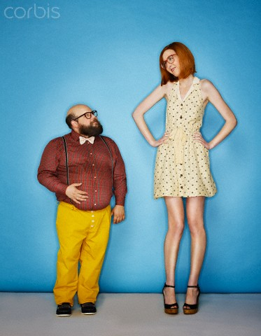
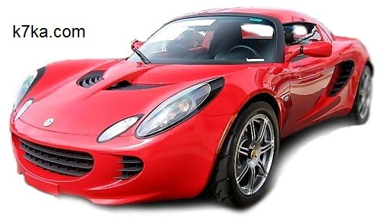
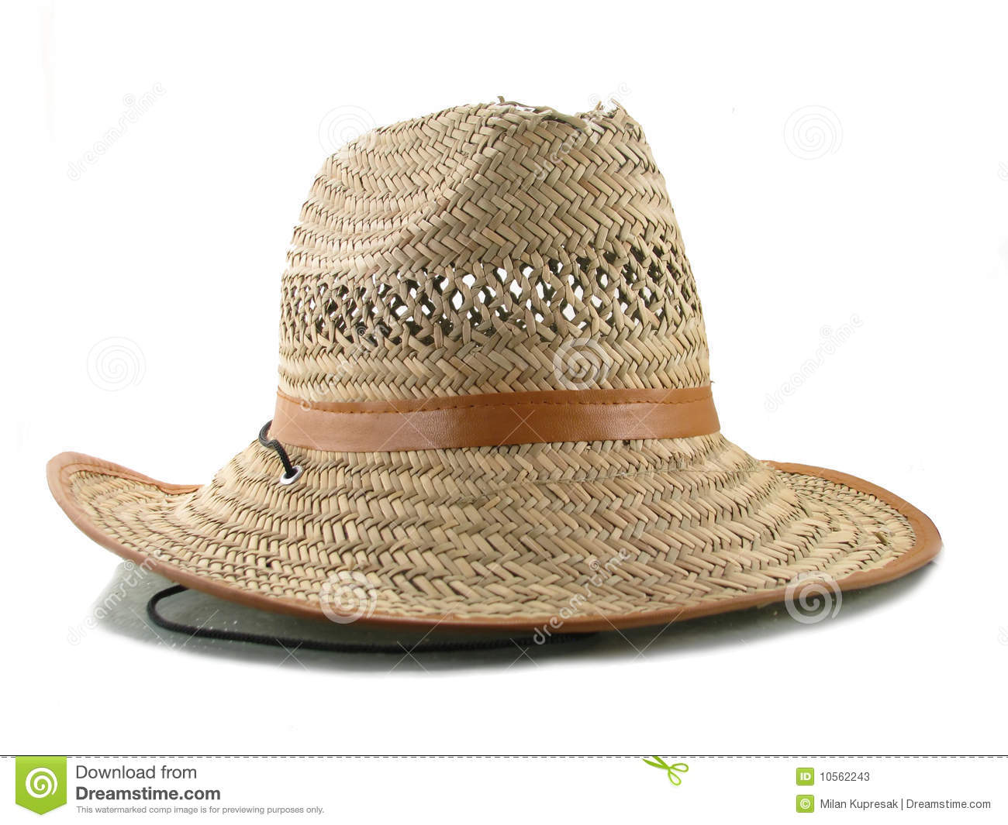
Where are adjectives placed in sentences?
Adjectives sometimes appear after the verb To Be
He is short.
She is tall.
Adjectives sometimes appear before a noun.
Red car
Old hat

Slide 4
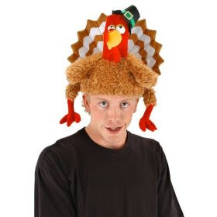
But…..
Sometimes you want to use more than one adjective to describe something (or someone).
What happens if a hat is both old AND ugly?
Do we say…
An ugly old hat?
OR
An old ugly hat?
An ugly old hat is correct because a certain order for adjectives is expected

Slide 5
So what is the correct order of adjectives when we put them before a noun or the thing they describe?
Here is a chart that shows the main word order for adjectives in English:

Slide 6
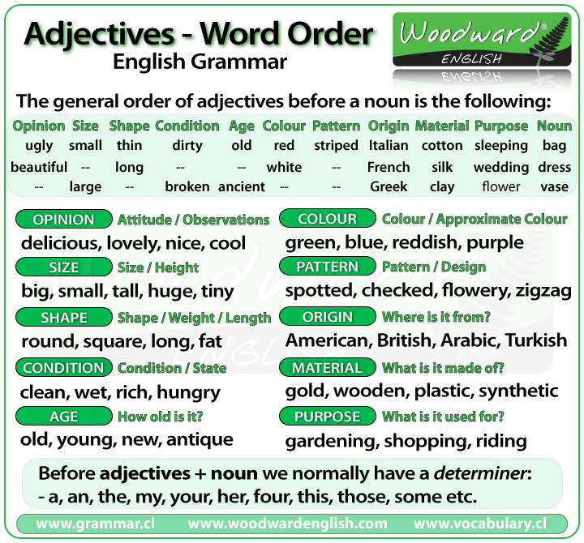

Slide 7


Types of Adjectives
Before the adjectives you will normally have the Determiner.
Determiner: The determiner tells us if the noun is singular or plural, definite or indefinite
a, an, the, my, your, two, those, some, etc
a tree
an apple
the door
my mother
your house
two windows
those students
some milk
And then we have the adjectives that refer to…

Slide 8
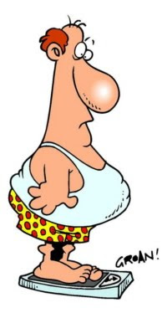
Opinion: Explains what we think about something. This is usually our opinion, attitude or observations. These adjectives almost always come before all other adjectives.
beautiful, boring, stupid, delicious, useful, lovely, comfortable
Size: Tells us how big or small something is.
big, small, tall, huge, tiny
Shape / Weight / Length: Tells about the shape of something or how long
or short it is. It can also refer to the weight of someone or something.
round, square, circular, skinny, fat, heavy, straight, long, short

Slide 9
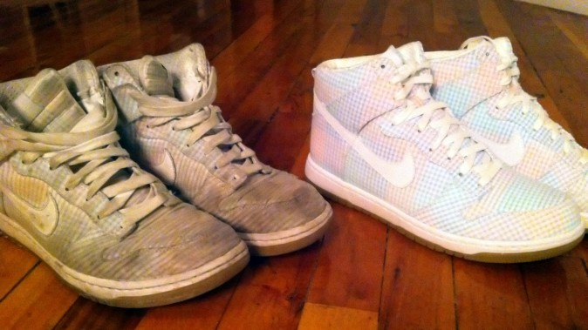
Condition: Tells us the general condition or state of something
broken, cold, hot, wet, hungry, rich, easy, difficult, dirty
Age: Tells us how old someone or something is.
old, young, new, ancient, antique
Colour: The colour or approximate colour of something.
green, white, blue, reddish, purple
Pattern: The pattern or design of something.
striped, spotted, checked, flowery

Slide 10
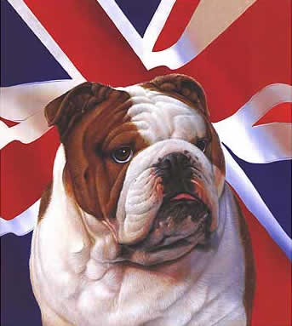
Origin: Tells us where something is from.
American, British, Italian, eastern, Australian, Chilean
Material: What is the thing made of or constructed of?
gold, wooden, silk, paper, synthetic, cotton, woollen
Purpose/Qualifier/Use: What is it for? These adjectives often end in –ing.
sleeping (bag), gardening (gloves), shopping (bag), wedding (dress)
If you look at the examples above, you can ask… what are the gloves used for? (gardening) What is the bag used for? (shopping)
And after these we adjectives we have the…
Noun: The person or thing that is being described

Slide 11
Examples of the order of adjectives before the noun
Something to have in mind is that it does not sound natural using three or more adjectives in the same sentence and it is very rare to hear four adjectives together before a noun.
A big fat dog.
An interesting old Indian rug.
A striped silk shirt
Some comfortable black sleeping bags
Four small round wooden tables
Those funny little old men

Slide 12
The End

