Slide 1
ADJECTIVES.

Slide 2
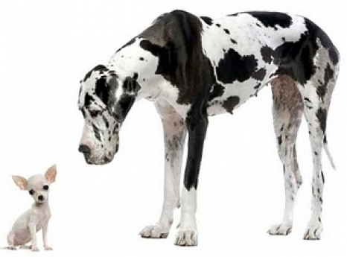
Small. Big.

Slide 3
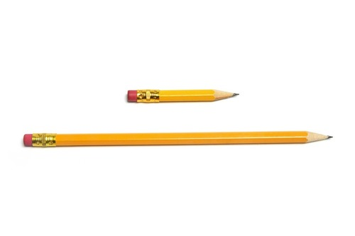
Short. Long.

Slide 4
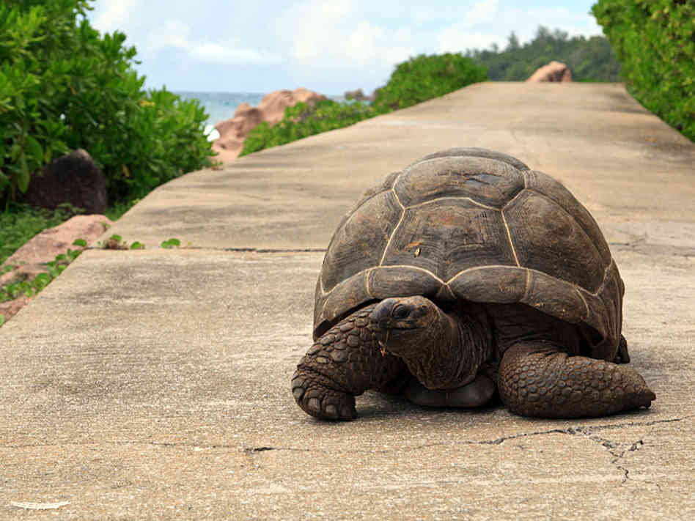
Slow

Slide 5
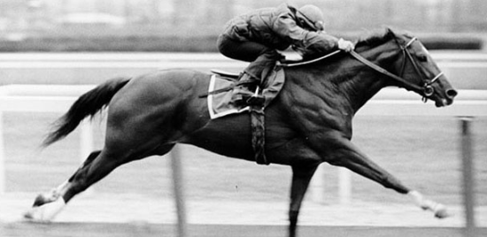
Fast

Slide 6

Safe

Slide 7

Dangerous

Slide 8

Easy

Slide 9
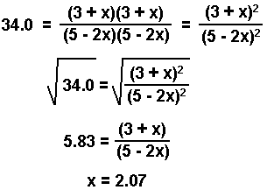
Difficult

Slide 10
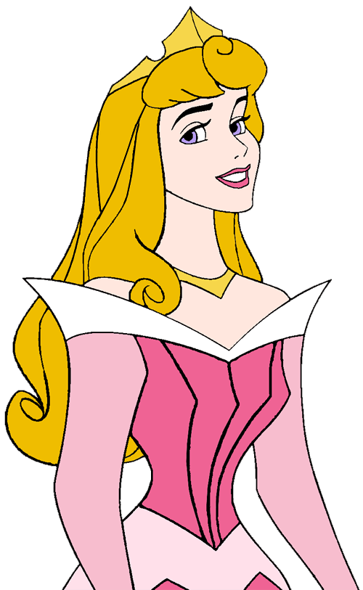
beautiful

Slide 11

Ugly horrible

Slide 12
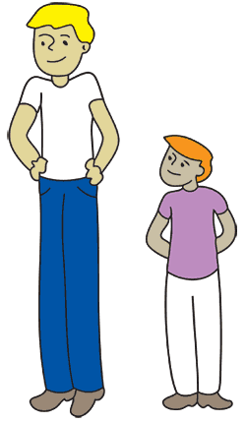
Tall short

Slide 13
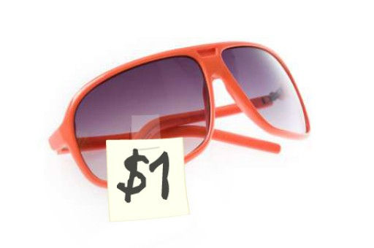
cheap

Slide 14
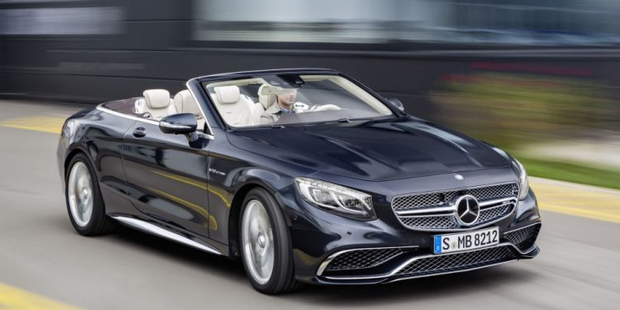
expensive

