Slide 1
ACTIVITIES

Slide 2

live

Slide 3

have

Slide 4
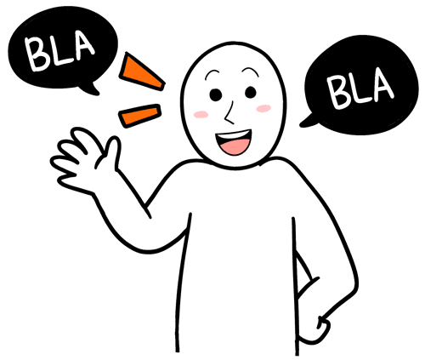
speak

Slide 5

teach

Slide 6

learn

Slide 7

study

Slide 8

read

Slide 9

write

